Slide 1
MODEL DETAILS
Different pre-release R values
We now explore a pre-release R value of 1.4.
Baseline levels was previously modelled at 1.0.
We explore 4 different scenarios:
Baseline
We model sequential vaccination of 3 sub-populations. Each vaccination schedule lasts 90 days and aims for 90% coverage of the available susceptibles, infecteds and recovereds in the vaccinated subpopulation at the beginning of the simulation.
After vaccination of each subpopulation, the sub-population is released from NPIs, with the R increasing from 1.4 to 4.2.
Full Release
We explore 3 different release scenarios:
First Group
We model a full release of the entire population (i, j and k) after the vaccination of the first sub-population (i) (after 90 days). This increases the R of the entire population from 1.4 to 4.2.
Middle Group
We model a full release of the entire population (i, j and k) after the vaccination of the second sub-population (j) (after 180 days). This increases the R of the entire population from 1.4 to 4.2.
Last Group
We model a full release of the entire population (i, j and k) after the vaccination of the final sub-population (k) (after 270 days). This increases the R of the entire population from 1.4 to 4.2.
Initial Conditions
S_{i} = 0.3064
S_{j} = 0.3064
S_{k} = 0.3064
I_{i} = 0.0071/3
I_{j} = 0.0071/3
I_{k} = 0.0071/3
V_{i} = 0
V_{j} = 0
V_{k} = 0
R_{i} = 0.073/3
R_{j} = 0.073/3
R_{k} = 0.073/3
Subpopulation i
Target Coverage = 90%
Duration = 90 days
Trigger Date = day 0
Subpopulation j
Target Coverage = 90%
Duration = 90 days
Trigger Date = day 90
Subpopulation k
Target Coverage = 90%
Duration = 90 days
Trigger Date = day 180

Slide 2
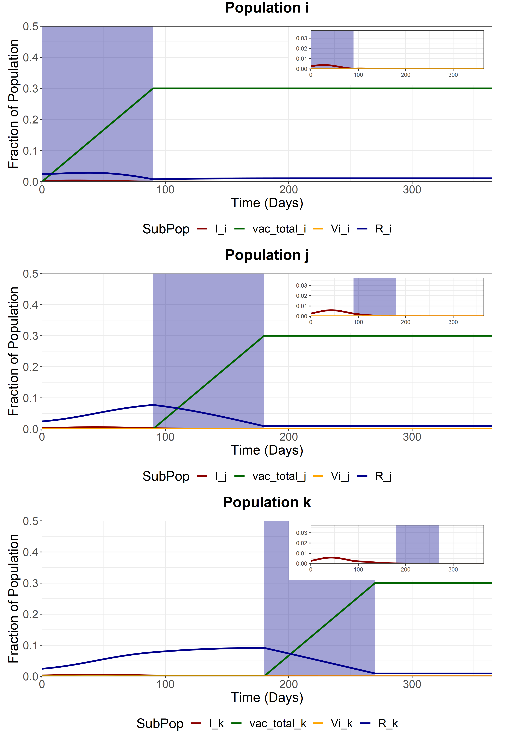
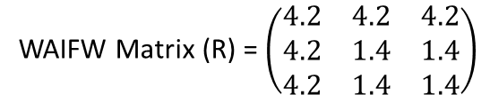
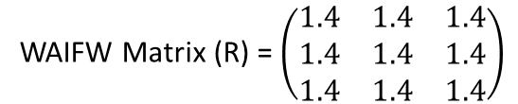
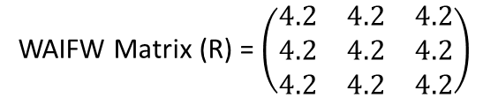
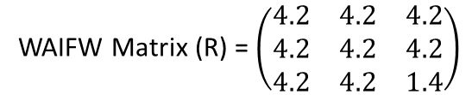
Baseline
We model sequential vaccination of 3 sub-populations. Each vaccination schedule lasts 90 days and aims for 90% coverage of the available susceptibles, infecteds and recovereds at the beginning of the simulation. After vaccination of each subpopulation, the sub-population is released from NPIs, with the R increasing from 1.4 to 4.2.
Note that at the end of the vaccination period, we do not see exactly 90% of each sub-population vaccinated. This is due to the effects of waning immunity and infection (and subsequent loss of immunity) during the vaccination period (90% of each subpop is ~0.3).
WAIFW Matrix (R) = $\left(\begin{matrix}1.4 & 1.4 & 1.4 \\ 1.4 & 1.4 & 1.4 \\ 1.4 & 1.4 & 1.4\end{matrix}\right)$
During the pop i vaccination (t = 0-90)
WAIFW Matrix (R) = $\left(\begin{matrix}4.2 & 4.2 & 4.2 \\ 4.2 & 1.4 & 1.4 \\ 4.2 & 1.4 & 1.4\end{matrix}\right)$
During the pop j vaccination (t = 90-180)
WAIFW Matrix (R) = $\left(\begin{matrix}4.2 & 4.2 & 4.2 \\ 4.2 & 4.2 & 4.2 \\ 4.2 & 4.2 & 1.4\end{matrix}\right)$
During the pop k vaccination (t = 180-270)
WAIFW Matrix (R) = $\left(\begin{matrix}4.2 & 4.2 & 4.2 \\ 4.2 & 4.2 & 4.2 \\ 4.2 & 4.2 & 4.2\end{matrix}\right)$
After final vaccination schedule (t = 270)

Slide 3
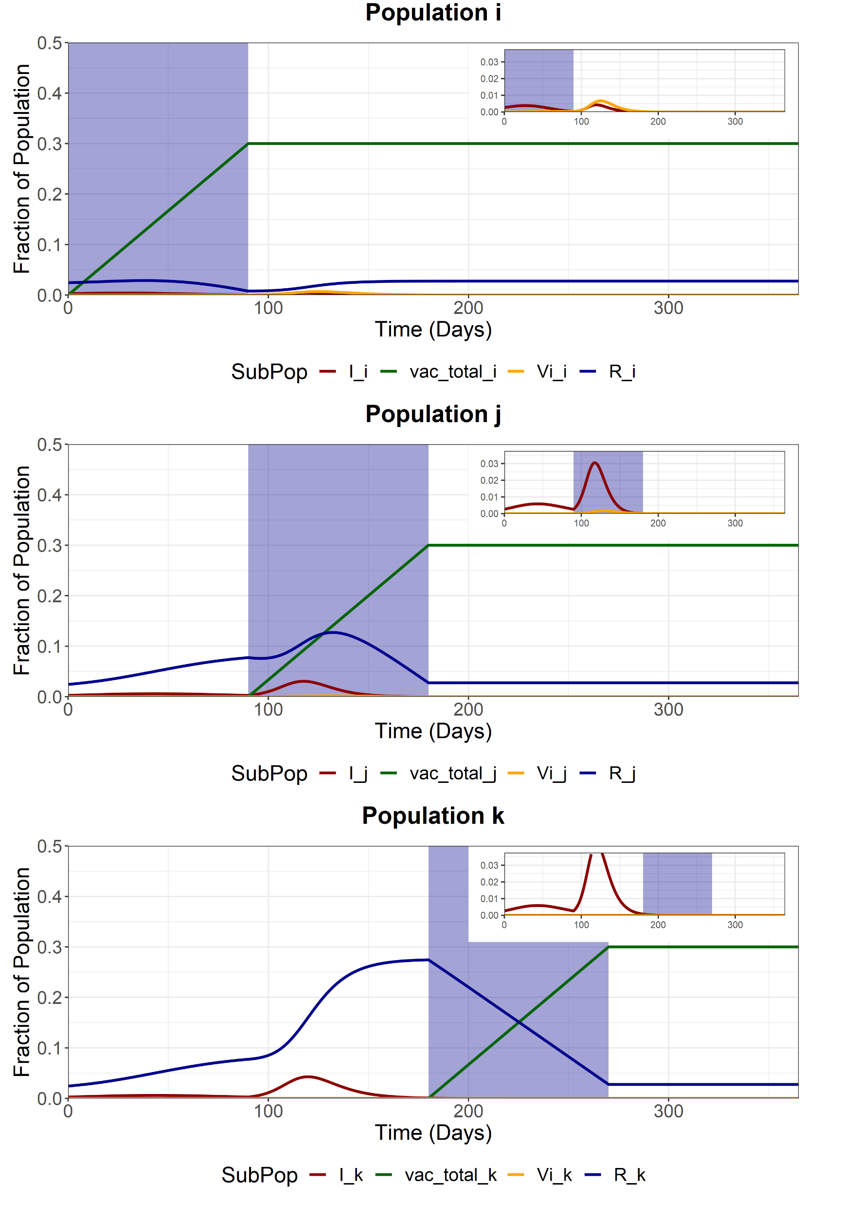
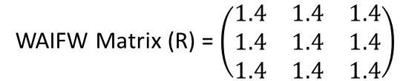
Full Release - First Group (i)
We model a full release of the entire population (i, j and k) after the vaccination of the first sub-population (i). This increases the R of the entire population from 1.4 to 4.2.
Note that at the end of the vaccination period, we do not see exactly 90% of the population vaccinated. This is due to the effects of waning immunity and infection (and subsequent loss of immunity) during the vaccination period (90% of each subpop is ~0.3).
WAIFW Matrix (R) = $\left(\begin{matrix}1.4 & 1.4 & 1.4 \\ 1.4 & 1.4 & 1.4 \\ 1.4 & 1.4 & 1.4\end{matrix}\right)$
Before first vaccination schedule (t < 90)
WAIFW Matrix (R) = $\left(\begin{matrix}4.2 & 4.2 & 4.2 \\ 4.2 & 4.2 & 4.2 \\ 4.2 & 4.2 & 4.2\end{matrix}\right)$
After first vaccination schedule (t > 90)

Slide 4
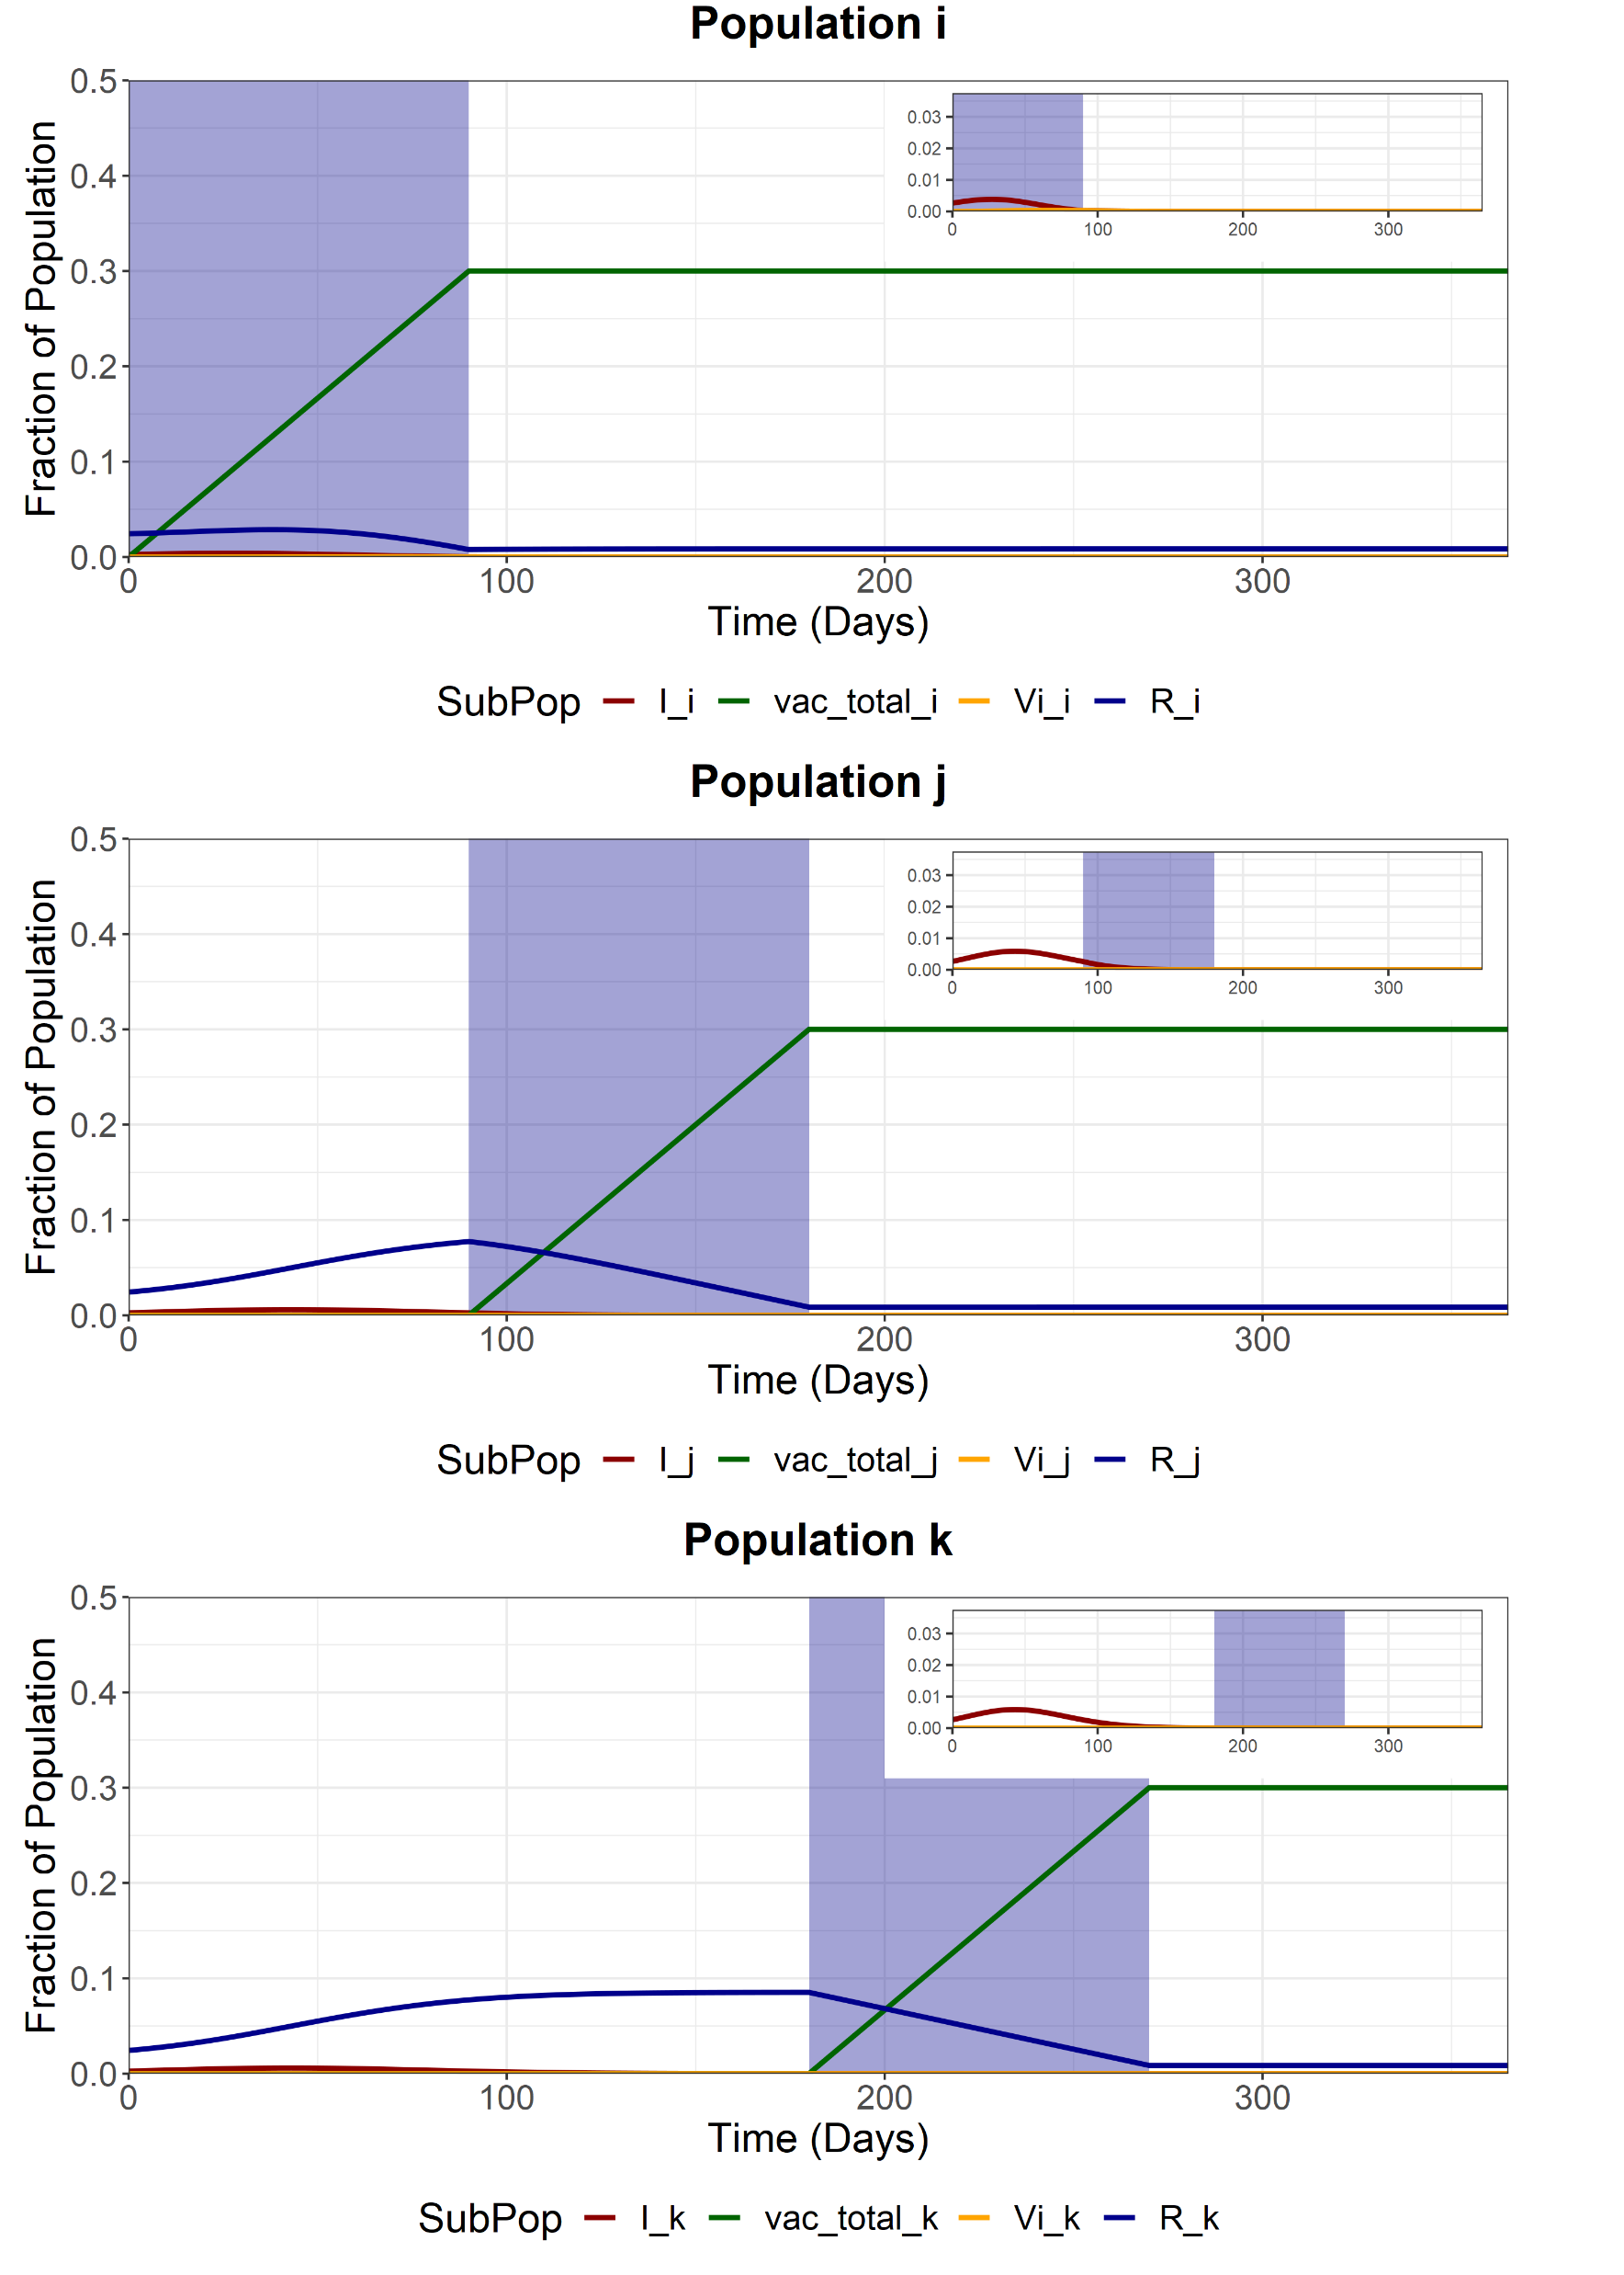
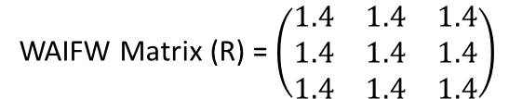
Full Release - Second Group (j)
We model a full release of the entire population (i, j and k) after the vaccination of the second sub-population (j). This increases the R of the entire population from 1.4 to 4.2.
Note that at the end of the vaccination period, we do not see exactly 90% of the population vaccinated. This is due to the effects of waning immunity and infection (and subsequent loss of immunity) during the vaccination period (90% of each subpop is ~0.3).
WAIFW Matrix (R) = $\left(\begin{matrix}1.4 & 1.4 & 1.4 \\ 1.4 & 1.4 & 1.4 \\ 1.4 & 1.4 & 1.4\end{matrix}\right)$
Before second vaccination schedule (t < 180)
WAIFW Matrix (R) = $\left(\begin{matrix}4.2 & 4.2 & 4.2 \\ 4.2 & 4.2 & 4.2 \\ 4.2 & 4.2 & 4.2\end{matrix}\right)$
After second vaccination schedule (t > 180)

Slide 5

Full Release - Second Group (k)
We model a full release of the entire population (i, j and k) after the vaccination of the last sub-population (k). This increases the R of the entire population from 1.4 to 4.2.
Note that at the end of the vaccination period, we do not see exactly 90% of the population vaccinated. This is due to the effects of waning immunity and infection (and subsequent loss of immunity) during the vaccination period (90% of each subpop is ~0.3).
WAIFW Matrix (R) = $\left(\begin{matrix}1.4 & 1.4 & 1.4 \\ 1.4 & 1.4 & 1.4 \\ 1.4 & 1.4 & 1.4\end{matrix}\right)$
Before final vaccination schedule (t < 270)
WAIFW Matrix (R) = $\left(\begin{matrix}4.2 & 4.2 & 4.2 \\ 4.2 & 4.2 & 4.2 \\ 4.2 & 4.2 & 4.2\end{matrix}\right)$
After final vaccination schedule (t > 270)

Slide 6
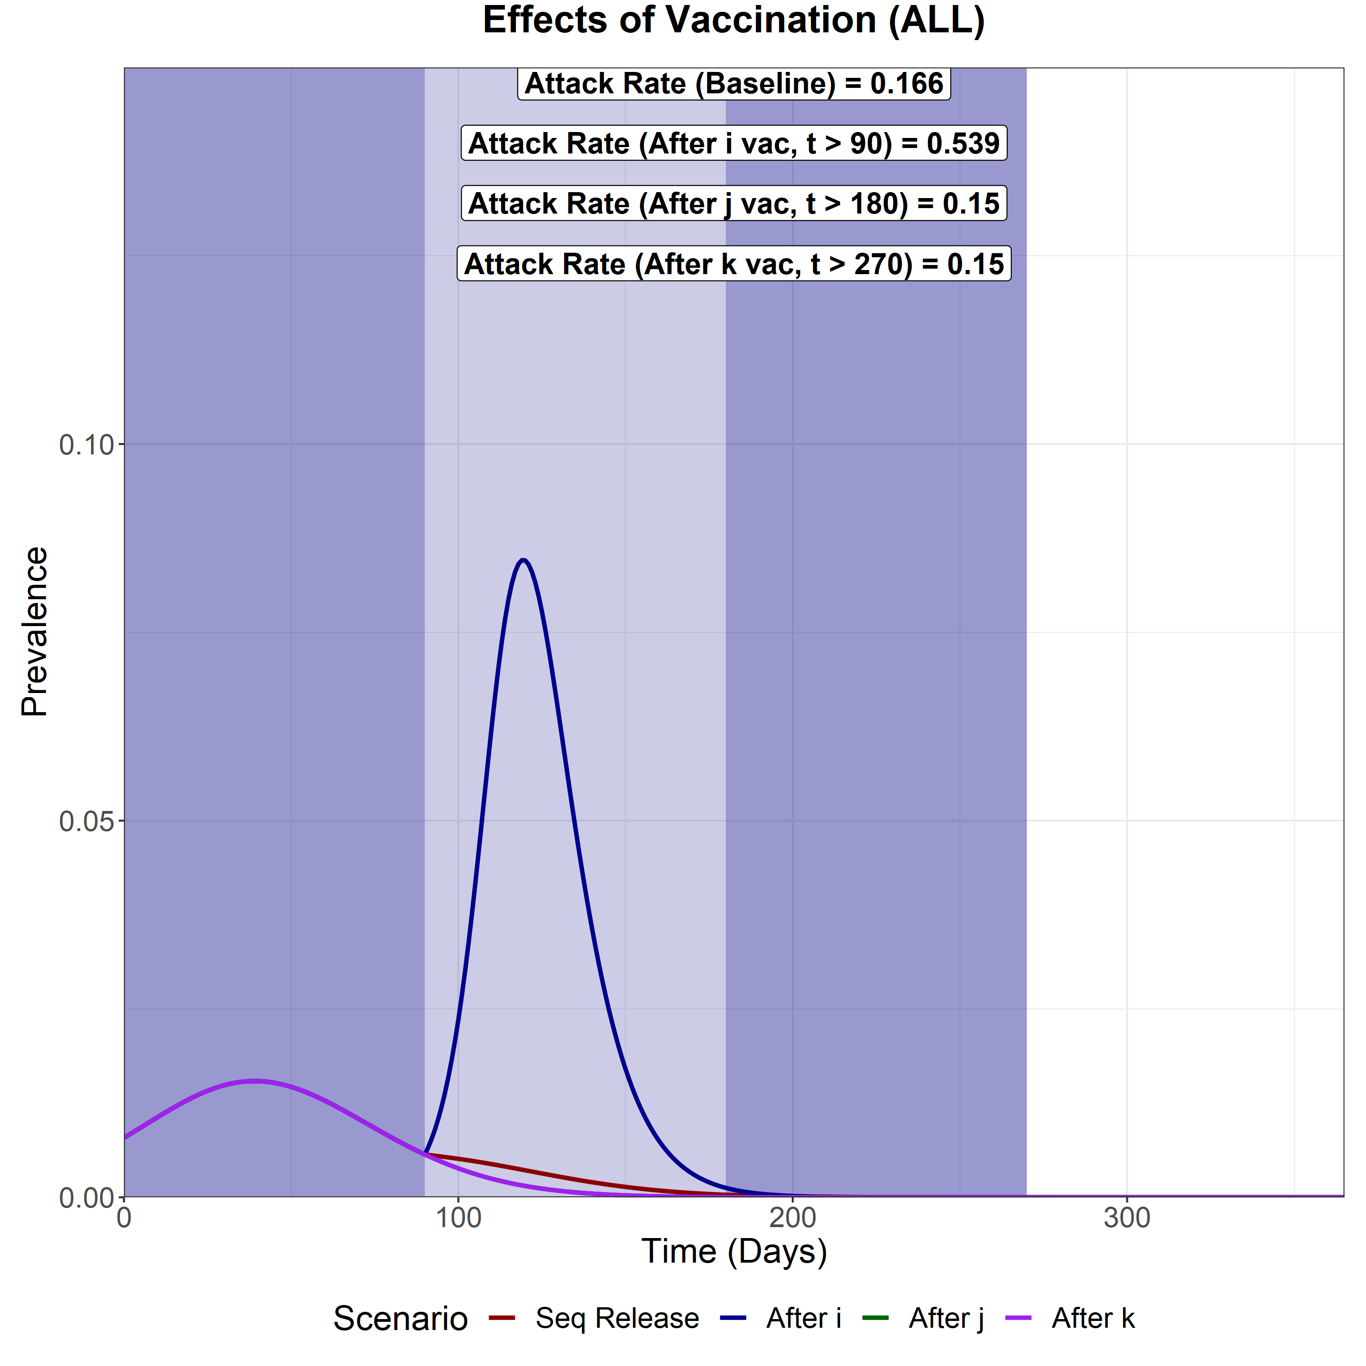
Scenario Analysis (Total Infected)
We now compare the total epidemic curve (the sum of the infectious compartment in each subpopulation) for 4 different scenarios:
With vaccination and sequential intervention release
Full release after vaccination of the first subpopulation (i)
Full release after vaccination of the second subpopulation (j)
Full release after vaccination of the last subpopulation (k)
The three shaded areas are the vaccination periods for subpopulation i, j and k respectively.
If we assume a baseline NPI R = 1.1, then all scenarios other than the earliest NPI release (release of pop i) will cause elimination.
The second worst is the sequential elimination strategy.
Full releases for the 180+ and 270+ day strategies have equal efficacy.

